Slide 1
Business contract validation- to classify content within the contract clauses & to determine deviations from templates & highlight them

Slide 2
Business Contract Validation Process
Collect Templates and Contracts
- Gather standard templates and existing contracts.
Define Classification Criteria
- Establish categories for clauses (e.g., payment terms, confidentiality).
Extract and Segment Clauses
- Extract text from contracts.
- Break down contracts into individual clauses.

Slide 3
Classify Clauses
- Assign each clause to the appropriate category.
Compare with Template
- Identify key elements in the template.
- Compare each clause against template clauses.
Highlight Deviations
- Mark deviations from the template clauses.
Decide on Actions
- Approve contracts as is or request revisions.

Slide 4
Update Templates and Criteria
- Refine templates and classification criteria based on feedback.
Automate and Use Tools
- Utilize contract management software for automation.
- Implement machine learning for improved accuracy.
Document and Report
- Record findings and decisions.
- Generate reports summarizing the validation process and deviations.

Slide 5
Architectural Approach to Business Contract Validation
Data Collection Layer
Input Sources: Templates, old contracts and any documents relevant.
Storage: Secure database for templates and contracts.
Preprocessing Layer
Text Extraction: Use OCR (Optical Character Recognition) for non-editable formats.
Text Segmentation: Break down documents into individual clauses.

Slide 6
Classification Layer
Machine Learning Models: Train models to classify clauses into predefined categories.
Rule-Based Systems: Implement rule-based algorithms for initial classification.
Comparison Layer
Template Matching: Compare each clause with standard template clauses.
Deviation Detection: Highlight differences and identify missing or extra clauses.
Automation and Tools Layer
Contract Management Software: Integrating software that automates extraction, classification, and comparison
Machine Learning Enhancements: Using ML to improve accuracy over time.

Slide 7
CODE
import streamlit as st
import fitz # PyMuPDF
from difflib import Differ
import spacy
# Load spaCy model
nlp = spacy.load("en_core_web_sm")
# Business contract template
template = """This Business Contract ("Agreement") is entered into on this [Date], by and between [Party A], located at [Party A's Address], and [Party B], located at [Party B's Address]. The parties agree to the following terms and conditions for the mutual benefit of both parties.

Slide 8
Scope of Work: [Party A] agrees to provide [specific services or products] to [Party B] as outlined in [detailed description of services/products]. This work shall be completed within [time frame], starting from the date of this Agreement. [Party B] agrees to provide necessary support and information to [Party A] to facilitate the timely and effective completion of the work.
Compensation and Payment Terms: In exchange for the services/products provided by [Party A], [Party B] agrees to pay a total amount of [specified amount] in accordance with the payment schedule outlined in [payment schedule details]. Payments shall be made via [preferred payment method] and are due [terms of payment, e.g., upon receipt of invoice, net 30 days]. Late payments will incur a [late fee/interest rate].
Confidentiality and Termination: Both parties agree to maintain the confidentiality of any proprietary information shared during the course of this Agreement. This Agreement may be terminated by either party with [number of days] written notice if the other party breaches any material term of this Agreement. Upon termination, [Party A] shall be compensated for all work completed up to the termination date, and all materials provided by [Party B] shall be returned promptly.""“
# Streamlit UI

Slide 9
st.title('Business Contract Validator’)
uploaded_file = st.file_uploader("Choose a PDF file", type="pdf")
if uploaded_file is not None:
# Extract text from PDF
doc = fitz.open(stream=uploaded_file.read(), filetype="pdf")
text = “”
for page in doc:
text += page.get_text()
st.text_area("Extracted Text", text, height=300)
# Compare extracted text with template
differ = Differ()
diff = list(differ.compare(template.splitlines(), text.splitlines()))
highlighted_diff = "\n".join(diff)
st.text_area("Highlighted Differences", highlighted_diff, height=300)

Slide 10
# Detect entities in the extracted text
doc = nlp(text)
entities = [(ent.text, ent.label_) for ent in doc.ents]
st.subheader("Detected Entities")
for entity in entities:
st.write(f"{entity[0]} ({entity[1]})")
# Show entities in the template
template_doc = nlp(template)
template_entities = [(ent.text, ent.label_) for ent in template_doc.ents]
st.subheader(“Template Entities”)
for entity in template_entities:
st.write(f"{entity[0]} ({entity[1]})")

Slide 11
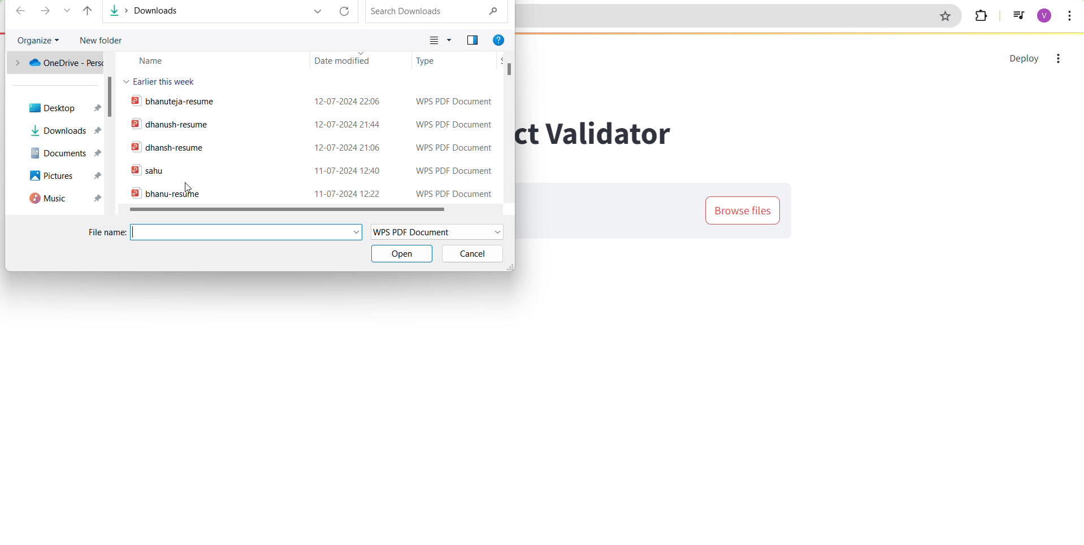

Slide 12
Team members and contribution
Team member 1 (Suchithra C):
Searched for sample business contracts
Helped in writing the code
Created the GitHub repo
Team member 2 (Sana Sayeeda):
Solved the Problem statement by writing a code in VScode
Made the Report\Presentation

Slide 13
Conclusion
It was a great time Participating in this program and we were able to finish the project.
Albert Einstein said “Logic will take you from A to B , but Imagination will take you everywhere”
Being able to imagine the problems will lead us to the answer rather than going behind the logics .
So I conclude by saying , please ignore any mistakes in the code . We tried giving our best.
I thank my teachers and the Intel Unnati Training team for giving us this opportunity.

Slide 14
thankyou

